Slide 1


WICCS-Tucson
Survey Methodology
Professor Samara Klar University of Arizona klar@arizona.edu

Slide 2
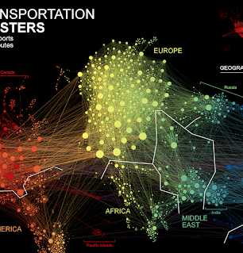
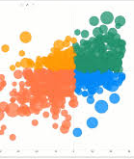

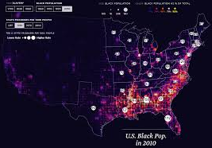
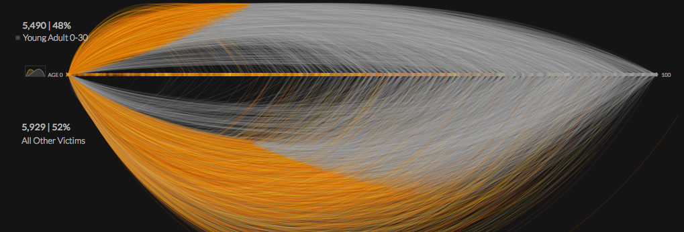

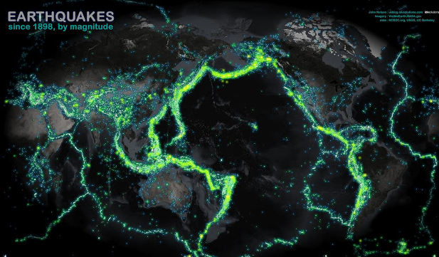
There is so much cool data out there.. why would a data scientist use a survey?

Slide 3

There is so much cool data out there.. Why would you use a survey??

Slide 4
Data can sometimes be observed... but sometimes not
Some traits of interest are directly observable
Electoral results, retweets, property value, voter registration, etc.
Some traits might be theoretically observable but are difficult to do so directly
Time spent on a website, likes on Facebook, vote preference, etc.
Others are not really observable at all
Preference toward policies, feelings toward out-party members, racist, sexist, other discriminatory beliefs, etc.

Slide 5
Surveys allows us to measure unobservables
Some traits of interest are directly observable
Electoral results, retweets, property value, voter registration, etc.
Some traits might be theoretically observable but are difficult to do so directly
Time spent on a website, likes on Facebook, vote preference, etc.
Others are not really observable at all
Preference toward policies, feelings toward out-party members, racist, sexist, other discriminatory beliefs, etc.

Slide 6
“Survey methodology” goes far beyond questionnaires and polls
Survey research involves directly asking individuals for feedback following any kind of treatment:
Asking for evaluations of stimuli
Measuring interest in stimuli through behaviors (clicks, subscriptions, sharing)
Soliciting photos, images, videos to express how individuals visualize concepts

Slide 7
Plan for Today
Hour 1: Some basics & some tricks
i. Sampling considerations
ii. Question ordering (post-treatment bias and priming)
iii. Methods to avoid socially desirable responding
iiii. Web-based surveys
iv. The scope of experiences that surveys can provide
Hour 2: Programming in Qualtrics

Slide 8
Survey data allow researchers to draw inferences with relatively smaller datasets
Probability sampling of small to large target populations
Purposive sampling of targeted populations
Convenience sampling for causal inference (later with Dr. Gonzalez)

Slide 9
Probability v. Non-Probability Sampling
Probability sampling: Each member of the population has an equal (non-zero) chance of being surveyed (e.g. Pew, Gallup)
Non-Probability sampling: Survey sample is skewed but can be weighted for accuracy (e.g. New York Times, SurveyMonkey, most election forecasting) if the intent is to infer about the entire population
Purposive sampling: A targeted convenience sample aimed at collecting data about a particular group

Slide 10
Purposive sampling allows researchers to focus on targeted groups
When the targeted group is small, even a large general population sampling frame will contain few members
If a group is hidden, oversampling may not be possible
Does not reply on probability-based sampling and has no design-based claim to representativeness

Slide 11
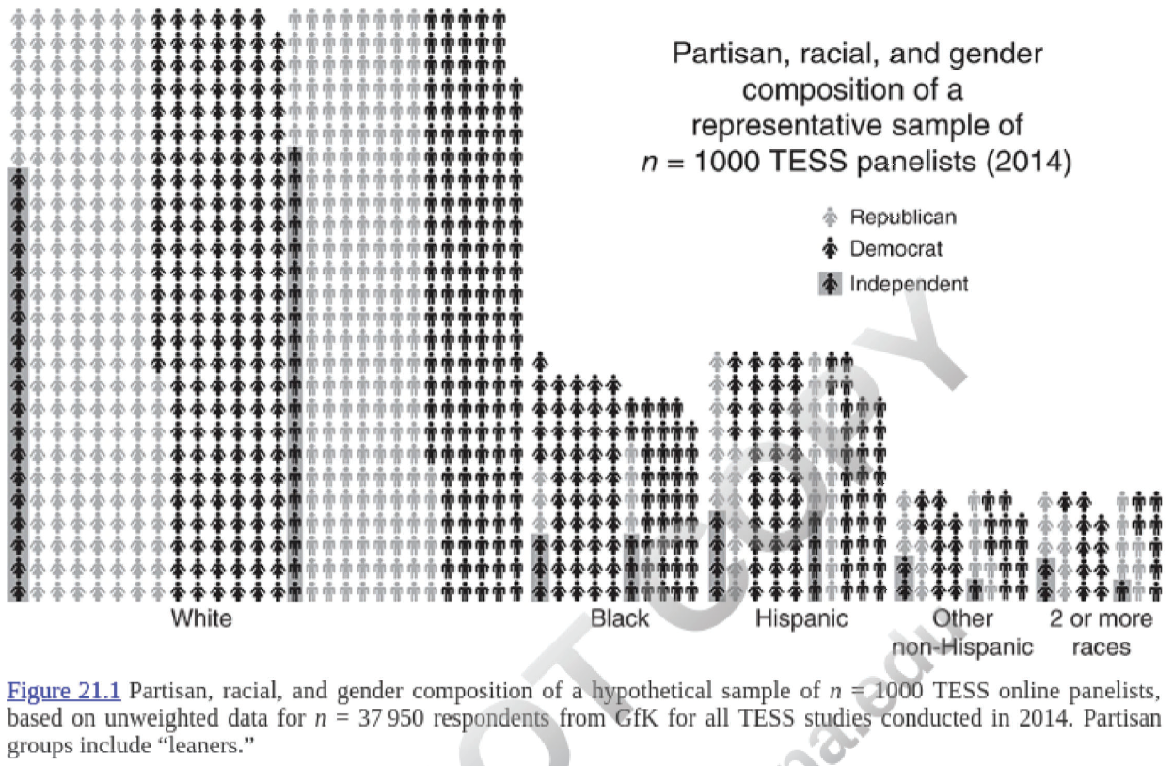
Purposive sampling allows researchers to focus on targeted groups

Slide 12
Designing your survey
Question wording
Reliability & validity
Test with split-sampling
Question order
Post-treatment bias
Priming effects

Slide 13
Post-treatment bias occurs when you condition your findings on later measures
Conditioning on a posttreatment variable changes the quantity of interest from an overall average treatment effect to a direct effect of the treatment net the posttreatment variable
The term post-treatment implies an experiment, but this can occur in surveys as well

Slide 14
Earlier questions can influence later questions
Do you believe businesses should be closed during the pandemic?
To what extent do you tolerate risk in order to pursue happy life?

Slide 15
Conditioning responses to Question 1 on Question 2 produce post-treatment bias
Do you believe businesses should be closed during the pandemic?
To what extent do you tolerate risk in order to pursue happy life?

Slide 16
A solution: ask question #2 first!
To what extent do you tolerate risk in order to pursue happy life?
Do you believe businesses should be closed during the pandemic?

Slide 17
A solution: ask question #2 first! BUT….
Now Question #1 might influence responses to questions #2!!
To what extent do you tolerate risk in order to pursue happy life?
Do you believe businesses should be closed during the pandemic?

Slide 18
Priming effects occur when a particular consideration becomes salient and influence subsequent evaluations
Now Question #1 might influence responses to questions #2!!
To what extent do you tolerate risk in order to pursue happy life?
Do you believe businesses should be closed during the pandemic?

Slide 19
How to weigh post-treatment bias against priming effects?
Ideal solution: multi-wave surveys
Problem: $$$$ (more on that later)
Split-sample
Problem: doubles your sample size
Pre-test with split-sample on cheap sample
Problem: might not apply to your sample
Probably the best solution

Slide 20
One major disadvantage with reporting unobservables
Privacy/embarrassment
Social desirability bias

Slide 21
Social desirability can creep into places unexpected
For example, church attendance rates among Americans are reported to be: 40-45%
Alternative: time diaries recording activities throughout the week
True church attendance: around 20%

Slide 22
Limitations of Behavioral Measures
Time diaries, beepers, GPS trackers, etc., are not practical for most attitudes

Slide 23
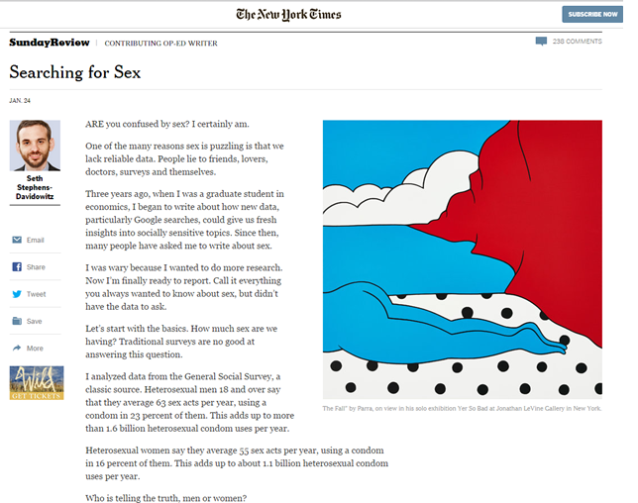
An Example of (Dis-)Honesty in Surveys

Slide 24
In the News: Honesty in Surveys
Heterosexual men over the age of 18 report to have engaged in 63 sexual acts per year
They report to have used a condom 23% of the time
This means that 1.6 billion condoms are used each year
Heterosexual women over the age of 18 report to have engaged in 55 sexual acts per year
They report to have used a condom 16% of the time
This means that 1.1 billion condoms are used each year
Already we suspect a problem ….
Women make of 51% of population
Estimated 2-10% of population engage in same-sex relations

Slide 25
In the News: Honesty in Surveys
Heterosexual men over the age of 18 report to have engaged in 63 sexual acts per year
They report to have used a condom 23% of the time
This means that 1.6 billion condoms are used each year
Heterosexual women over the age of 18 report to have engaged in 55 sexual acts per year
They report to have used a condom 16% of the time
This means that 1.1 billion condoms are used each year
A second problem…..
According to consumer data, 600 million condoms are sold each year

Slide 26
Experimental techniques can help solicit honesty responding
Psychological batteries
List experiments
Justifications

Slide 27
List Experiments or Item Count Techniques
“Racial Prejudice and Attitudes toward Affirmative Action” by James Kuklinski, Paul Sniderman, Kathleen Knight, Thomas Piazza, Philip Tetlock, Gordon Lawrence, and Barbara Mellers (1997)
Method: Take a large, representative sample of the population and randomly divided it into 2 groups

Slide 28
“Racial Prejudice and Attitudes toward Affirmative Action”
Group 1 was presented with a list of 3 items
Asked to say how many of the 3 items made them angry
NOT which ones – just how many
Group 2 was presented with the same list of 3 items with one extra item added
The extra item had to do with race
Asked to say how many of the 3 items made them angry
NOT which ones – just how many

Slide 29
“Racial Prejudice and Attitudes toward Affirmative Action”
Survey given to Group 1:
“Please read the following 3 things that sometimes make people angry or upset. After, identify HOW MANY of them upset you. Not which ones, just HOW MANY.”
1. The federal government increasing taxes on gasoline
2. Professional athletes getting million-dollar salaries
3. Large corporations polluting the environment

Slide 30
“Racial Prejudice and Attitudes toward Affirmative Action”
Survey given to Group 2:
“Please read the following 3 things that sometimes make people angry or upset. After, identify HOW MANY of them upset you. Not which ones, just HOW MANY.”
1. The federal government increasing taxes on gasoline
2. Professional athletes getting million-dollar salaries
3. Large corporations polluting the environment
4. A minority family moving in to the house next door to yours

Slide 31
“Racial Prejudice and Attitudes toward Affirmative Action”
Analysis: Compare the average number of items that make people upset in each group.
The researchers looked at people living in the South versus those not living in the South

Slide 32
“Racial Prejudice and Attitudes toward Affirmative Action”
Non-Southern respondents
Group 1: 2.28
Group 2: 2.24

Slide 33
“Racial Prejudice and Attitudes toward Affirmative Action”
Non-Southern respondents
Group 1: 2.28
Group 2: 2.24
Mean in second group is lower
Difference is calculated as: [2.28-2.24]*100 = 4%

Slide 34
“Racial Prejudice and Attitudes toward Affirmative Action”
Non-Southern respondents
Group 1: 2.28
Group 2: 2.24
Mean in second group is lower
Difference is calculated as: [2.28-2.24]*100 = 4%
(Not a statistically significant difference)

Slide 35
“Racial Prejudice and Attitudes toward Affirmative Action”
Southern respondents
Group 1: 1.95
Group 2: 2.37

Slide 36
“Racial Prejudice and Attitudes toward Affirmative Action”
Southern respondents
Group 1: 1.95
Group 2: 2.37
Mean in Group 2 is higher
Difference is calculated as:

Slide 37
“Racial Prejudice and Attitudes toward Affirmative Action”
Southern respondents
Group 1: 1.95
Group 2: 2.37
Mean in Group 2 is higher
Difference is calculated as: [2.37-1.95]*100 =

Slide 38
“Racial Prejudice and Attitudes toward Affirmative Action”
Southern respondents
Group 1: 1.95
Group 2: 2.37
Mean in Group 2 is higher
Difference is calculated as: [2.37-1.95]*100 = 42%

Slide 39
“Racial Prejudice and Attitudes toward Affirmative Action”
The authors are able to conclude that, among Southern respondents, 42% would be upset if a minority family moved in next door.

Slide 40
“Social Desirability Effects and Support for a Female American President”
Background:
Paper by Matthew Streb, Barbara Burrell, Brian Frederick, and Michael A. Genovese
Respondents may be unwilling to admit that they are uncomfortable with a female president

Slide 41
“Social Desirability Effects and Support for a Female American President”
Method:

Slide 42
“Social Desirability Effects and Support for a Female American President”
Method:
Randomly divide the sample into 2 groups

Slide 43
“Social Desirability Effects and Support for a Female American President”
Method:
Group 1 read:
“How many of the following four statements make you angry or upset:”
The way gasoline prices keep going up.
Professional athletes getting million dollar-plus salaries
Requiring seat belts to be used when driving
Large corporations polluting the environment

Slide 44
“Social Desirability Effects and Support for a Female American President”
Method:
Group 2 read:
“How many of the following four statements make you angry or upset:”
The way gasoline prices keep going up.
Professional athletes getting million dollar-plus salaries
Requiring seat belts to be used when driving
Large corporations polluting the environment
A woman serving as president

Slide 45
“Social Desirability Effects and Support for a Female American President”
Results:
Group 1 Mean Response: 2.16
Group 2 Mean Response: 2.42
Calculate Difference:

Slide 46
“Social Desirability Effects and Support for a Female American President”
Results:
Group 1 Mean Response: 2.16
Group 2 Mean Response: 2.42
Calculate Difference: [2.42-2.16] *100 = 26%

Slide 47
“Education and Social Desirability Bias: The Case of a Black Presidential Candidate”
Background:
Paper by Jennifer Heerwig and Brian McCabe written in 2009
Respondents may not want to admit their true (racist) feelings about a Black Presidential candidate

Slide 48
“Education and Social Desirability Bias: The Case of a Black Presidential Candidate”
Method:

Slide 49
“Education and Social Desirability Bias: The Case of a Black Presidential Candidate”
Method:
Divide into 2 groups!

Slide 50
“Education and Social Desirability Bias: The Case of a Black Presidential Candidate”
Method:
Group 1:
How many of the following three statements do you agree with?
Presidential campaigns are too costly
We need stronger immigration laws
The war in Iraq will ultimately make the USA safer

Slide 51
“Education and Social Desirability Bias: The Case of a Black Presidential Candidate”
Method:
Group 2:
How many of the following three statements do you agree with?
Presidential campaigns are too costly
We need stronger immigration laws
The war in Iraq will ultimately make the USA safer
I am willing to support a Black Presidential candidate

Slide 52
“Education and Social Desirability Bias: The Case of a Black Presidential Candidate”
Results:
Education Level | Group 1 | Group 2 | Estimated True Support for a Black Candidate
Less than High School
High School
Some College
College Degree or more

Slide 53
“Education and Social Desirability Bias: The Case of a Black Presidential Candidate”
Results:
Education Level | Group 1 | Group 2 | Estimated True Support for a Black Candidate
Less than High School | 1.82 | 2.26 | 44%
High School | 1.86 | 2.43 | 57%
Some College | 1.78 | 2.55 | 77%
College Degree or more | 1.89 | 2.81 | 92%

Slide 54
Measuring Drug and Alcohol Use Among Student-Athletes
Group 1:
“Below is a list of activities that you may have engaged in over your time in college. We are interested in HOW MANY of these activities you have engaged – NOT which ones. Thus, please simply choose the number at the end of the list.”
Sustained an injury during a practice or game that prevented you from playing at least one other game.
2. Joined a social club whose majority of members did/does not include varsity athletes.
3. Skipped a class because you felt so tired from a practice or a game.
4. Was unable to take a class that you hoped to take because of your practice or game schedule.

Slide 55
Measuring Drug and Alcohol Use Among Student-Athletes
Group 2:
“Below is a list of activities that you may have engaged in over your time in college. We are interested in HOW MANY of these activities you have engaged – NOT which ones. Thus, please simply choose the number at the end of the list.”
Sustained an injury during a practice or game that prevented you from playing at least one other game.
2. Joined a social club whose majority of members did/does not include varsity athletes.
3. Skipped a class because you felt so tired from a practice or a game.
4. Was unable to take a class that you hoped to take because of your practice or game schedule.
5. Knowingly took a drug banned by the NCAA that may improve your athletic performance.

Slide 56
Measuring Drug and Alcohol Use Among Student-Athletes
RESULTS:
Mean for Group 1:
Mean for Group 2:

Slide 57
Measuring Drug and Alcohol Use Among Student-Athletes
RESULTS:
Mean for Group 1: 3.31
Mean for Group 2: 3.68
How do we calculate the difference?

Slide 58
Measuring Drug and Alcohol Use Among Student-Athletes
RESULTS:
Mean for Group 1: 3.31
Mean for Group 2: 3.68
How do we calculate the difference?
[3.68-3.31] + 100 = 37%

Slide 59
Measuring Drug and Alcohol Use Among Student-Athletes
RESULTS:
What was the result when asked directly??

Slide 60
Measuring Drug and Alcohol Use Among Student-Athletes
RESULTS:
What was the result when asked directly??
4.9%

Slide 61
Measuring Drug and Alcohol Use Among Student-Athletes
Group 1:
“Below is a list of activities that you may have engaged in over your time in college. We are interested in HOW MANY of these activities you have engaged – NOT which ones. Thus, please simply choose the number at the end of the list.”
1. Your choice of which University to attend was determined largely by the sports opportunities (e.g., it weighed in at least in 50% of your decision).
2. Stayed up past 1AM, on average, during the season of your sport(s).
3. Plan to continue playing your sport after college, although not necessarily on the professional level.
4. Play other sports during the school year at least once a month.

Slide 62
Measuring Drug and Alcohol Use Among Student-Athletes
Group 1:
“Below is a list of activities that you may have engaged in over your time in college. We are interested in HOW MANY of these activities you have engaged – NOT which ones. Thus, please simply choose the number at the end of the list.”
1. Your choice of which University to attend was determined largely by the sports opportunities (e.g., it weighed in at least in 50% of your decision).
2. Stayed up past 1AM, on average, during the season of your sport(s).
3. Plan to continue playing your sport after college, although not necessarily on the professional level.
4. Play other sports during the school year at least once a month.
5. In the typical week during the past academic year, consumed more than five alcoholic drinks (A drink can be a 12-ounce beer or wine cooler a 4 ounce glass of wine, or a shot of liquor either straight or in a mixed drink.)

Slide 63
Measuring Drug and Alcohol Use Among Student-Athletes
RESULTS:
Mean for Group 1: 2.76
Mean for Group 2: 3.22
[3.68-3.31] + 100 = 46%

Slide 64
Measuring Drug and Alcohol Use Among Student-Athletes
RESULTS:
What was the result when asked directly??

Slide 65
Measuring Drug and Alcohol Use Among Student-Athletes
RESULTS:
What was the result when asked directly??
“In the typical week during the past academic year, how many alcoholic beverages do you consume? (A drink can be a 12-ounce beer or wine cooler a 4 ounce glass of wine, or a shot of liquor either straight or in a mixed drink.).”
Mean response: 2.44

Slide 66
List Experiments
Two Important Assumptions:
Including the sensitive item does not affect responses about the non-sensitive items
Responses about the sensitive item are truthful
Kosuke Imai proposes statistical methods to measure the degree to which these assumptions are violated:
http://imai.princeton.edu/talk/files/NJIT10.pdf

Slide 67
Allowing for “justification” to prevent socially desirable responding
Yanna Krupnikov and Spencer Piston
Experiment
Subjects randomly assigned to one of 6 groups (or “conditions”)

Slide 68
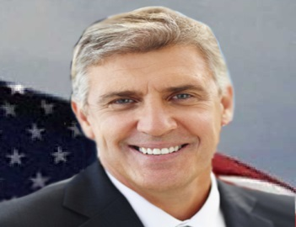
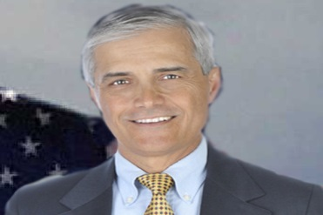
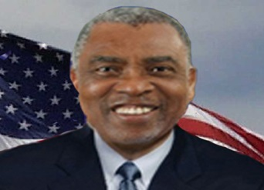
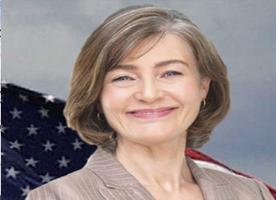
Experimental Design
Respondents were shown 2 fictitious candidates:
This Guy: … and ONE of these 3 people:

Slide 69
Experimental Design
They were also randomly assigned to either
JUSTIFY why they chose their candidate
NOT just why chose their candidate

Slide 70
Six Conditions
 | Justify | Not Justify
White man vs. White man | 1 | 2
White man vs. Black man | 3 | 4
White man vs. White woman | 5 | 6

Slide 71
Experimental Design
When respondents were able to justify their choice, they were LESS LIKELY to select the female or minority candidate

Slide 72
Social Desirability
Self-Reports are a convenient and frequently effective technique to conduct research in the social sciences
But Social Desirability Bias can cast doubt on our results
The List Experiment is one technique to uncover honest responses
Justification for Response is a second technique to uncover honest responses
BOTH OF THESE TECHNIQUES REQUIRE:
Random Assignment into Treatment Groups

Slide 73
Measuring social desirability bias in responsenses through psychological batteries

Slide 74
Norms and Social Desirability
When the mass public appear to approve of particular attitudes and behaviors, individuals are prone to report engage in them.
Examples:
Criminal activity
Discriminatory attitudes
Voting turnout
Candidate choice

Slide 75
Susceptibility to Social Desirability Bias
High self-monitors are most prone to social desirability bias.
“Self-Monitoring Scale”:
In a group, I like to be the center of attention.
I am always courteous no matter how unpleasant someone else might be.
I would make a very good actor.

Slide 76
By increasing self-monitoring, we can:
See if a particular response is socially desirable
Identify who is particularly like to give socially desirable responses

Slide 77
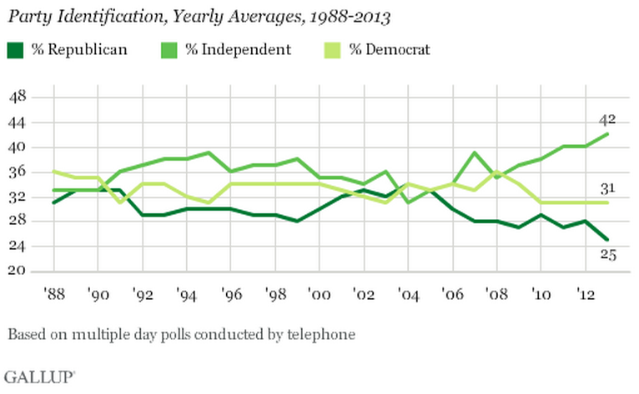
An example: most Americans are independents
Notes:
As you surely know, these days, most Americans say that they are independent. Recently, independents have overtaken both Democrats and Republicans as the largest group in the electorate. Now this does include both pure independents, who claim to have no party preference, and leaners, who will admit, when pressed, that they do prefer one of the two parties. But what’s important here is that most Americans, when asked, would rather say they are independent than admit to being a partisan.

Slide 78
Is the appeal of independence due to social desirability bias?
Notes:
We then had to test whether this finding is truly an outcome of social desirability bias?

Slide 79
Is the appeal of independence due to social desirability bias?
Nationally representative sample of 800 adults
Conducted experiment in February of 2013
Notes:
To do so, we recruited a sample of 800 adults via YouGov. The panel of respondents had provided their partisanship one year prior, in 2012, so we had a meaure of their partisan identity before we conducted this experiment in February of 2013.

Slide 80
Is the appeal of independence due to social desirability bias?
1. Before the procedure we measured self-monitoring.
Notes:
Before we proceded with the experiment, we first measured what is called “self-monitoring” across all of our respondents.

Slide 81
The “Self-Monitoring” scale rates susceptibility to social desirability bias
Scale developed by psychologists (Snyder 1979).
High self-monitors are most prone to social desirability bias.
Sample components of “Self-Monitoring Scale”:
In a group, I like to be the center of attention.
I am always courteous no matter how unpleasant someone else might be.
I would make a very good actor.
Notes:
Self-monitoring is a psychological scale that indicates how suscepitble someone is to social desirability bias. Someone who is high in self-monitoring is attuned to the way others think of him and he adjust his behaviors and attitudes accoringly. Someone who is love in self-monitoring is less concerned with adjusting his behavior to suit others. The self-monitoring scale has been used extensively in political science to identify individuals who are more or less likely to provide socially dsirbale response options on surveys.
The scale includes components such as “in a group, I like to be the center of attention.” “I am always courteous no matter how unpleasant someone else might be.” and “I would make a very good actor.”

Slide 82
Is the appeal of independence an outcome of social desirability bias?
2. After measuring self-monitoring:
Respondents randomly assigned to read one news article:
Article about partisan unity in Washington
Article about partisan disagreement in Washington
Article about Groundhog Day (control)
Notes:
After measuring self-monitoring across our respondents, they were then randomly assigned to read one news article. The first article discussed the potential for partisan cooperation in Washington. The second addressed the potential for partisan bickering in washington. The third was a non-partisan issue about the origins of the great holiday Groundhog Day. To my knowledge, and I could be wrong, Groundhog Day has not yet become a partisan issue.

Slide 83
Is the appeal of independence an outcome of social desirability bias?
3. Finally:
Party Identification
Issue Positions
Notes:
After reading each article, individuals were simply asked to provide their party identification and their position on several policies.

Slide 84
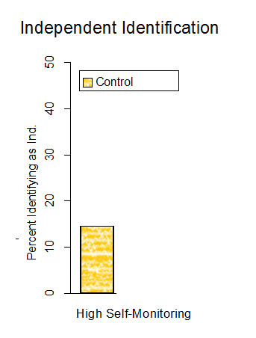
Percent Identifying as Independent: High Self-Monitors Only
Notes:
First, let’s take a look at how self-monitors responded to the party identification question after reading each article. Remember that high self-monitors are individuals who are most susceptible to social desirability bias. We first see that about 15% of high self-monitors who read about Groundhog Day subsequently identified themselves as independent.

Slide 85
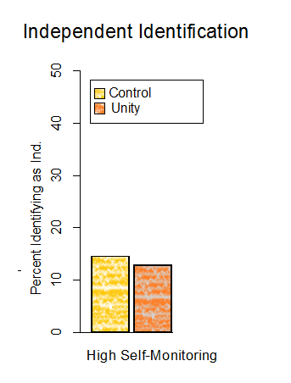
Percent Identifying as Independent: High Self-Monitors Only
Notes:
Among those who read about partisan unity, we see very little change. Certianly nothing signficant.

Slide 86
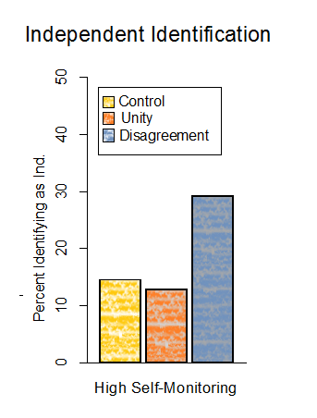
Percent Identifying as Independent: High Self-Monitors Only
Socially desirable responding
Notes:
When high self-monitors read about partisan disagreement, howver, we see a dramatic increase in the percentage that subsequently call themseles “independent. Exposure to partisan disagreement appears to increase the social desirability of indepence and the tendency to identify as such.
Now we expect that for low self-monitors – people who care little about ajusting their behaviors – we should not find this same pattern.

Slide 87
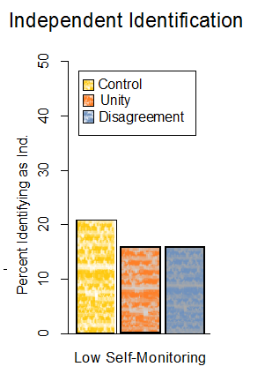
Percent Identifying as Independent: Low Self-Monitors Only
Socially desirable responding
Notes:
Indeed among low self-monitors, exposure to partisan disagreement does not result in any changes.

Slide 88
Today, surveys are almost exclusively web-based
Internet-based opt-in panels (e.g. YouGov)
Streaming panels (e.g. SurveyMonkey)
Generally weighted to represent the population based on census data

Slide 89
This increases access at varying costs
10-minute study, 1000 people, nationally representative, one-wave
MTurk: $1,400 (assumes federal minimum wage)
Dynata: $4,000
YouGov: $10,000
NORC: $22,700 (AmeriSpeak Panel)
IPSOS: $34,489

Slide 90
It also allows for a range of survey experiences
Images, video, etc.
Interaction
Simulated environments

Slide 91
Generally, survey companies will ask that you program your own survey for distribution
Software are widely available, each with different benefits
Key advantage of Qualtrics: randomization
Using customization and javascript, surveys have huge potential

Slide 92
Part 2! Qualtrics….
Accounts are often available through your instititution
Free accounts do not let you export data!

Slide 93
Thank you!
It’s been a pleasure!
Please contact me any time! klar@arizona.edu

